Slide 1


Lecture with Computer Exercises:
Modelling and Simulating Social Systems with MATLAB
SIG – Sequential Investment Game
Fabian Keller, Sebastian Klotz, Simon Zimmermann

Slide 2
Contents
Simon
Motivations
Theoretical Background
Research Question
Implementation
Summary, Conclusion & Outlook
Sebastian
Fabian
Simon
Sebastian
Simon
Fabian
Fabian

Slide 3
Motivations
Simon
GESS course
MATLAB
LaTex
Social research
Project
Game theory

Slide 4
Theoretical Background
Sebastian
Game Theory
Model conflicts between rational parties
Nash Equilibrium
Economics, computer science, biology
Evolutionary Game Theory
Not aiming for maximum gain
Winning is the only matter of importance

Slide 5
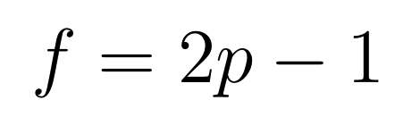
Theoretical Background
Sebastian
Kelly criterion
1 player against the house
Constant bet
Optimal fraction for maximum output
Closed form solution:
For p = 60% : f = 20%

Slide 6
Theoretical Background
Fabian
Sequential Investment Game
2 Players
Sequence of investments
Game > Round > Turn
Example:
Win Loss
B = 20% | 1 | 2 | 3 | 4 | 5 | 6 | 7 | 8 | 9 | 10
100 | 80 | 64 | 76.8 | 92.2 | 73.7 | 59 | 70.7 | 84.9 | 101.9 | 122.3
100 | 120 | 144 | 172.8 | 138.2 | 110.6 | 132.7 | 106.1 | 84.9 | 67.9 | 81.5

Slide 7
Research question
Simon
„Is there a Nash equilibrium for our expended problem?“
player(s) have no intention to change
If yes: How does it look like and why?
→ Research process: different Versions

Slide 8
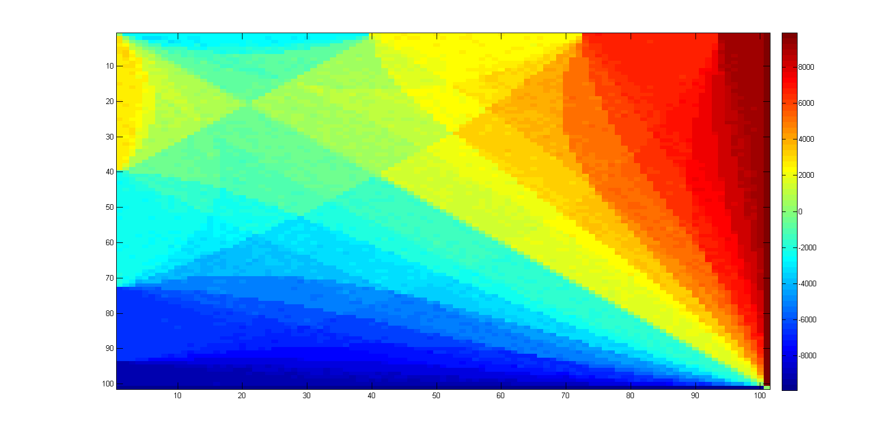
Implementation – Version 1
Sebastian
Reference Matrix
Player 1
Player 2

Slide 9
Implementation – Version 2
Simon
Two assumptions too restrictive:
1.) players stick to their strategies during one round
2.) memory of the players
→ New approach: random strategies

Slide 10
Implementation – Version 2
Simon
both players choose random strategies
every bet between 10 % and 30 % in 2.5 % - steps
play one round for several times
winner sticks to strategy
loser changes strategy again randomly
counting of most used winning strategies

Slide 11
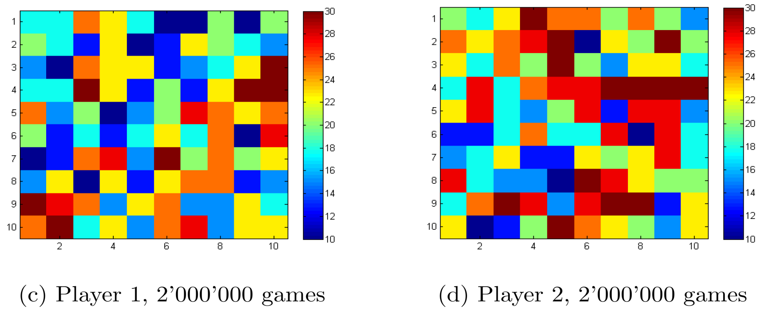
Implementation – Version 2
Simon
→ run the code with high iteration numbers:
Result: no pattern
Conclusion: still too less iterations

Slide 12
Implementation – Version 3
Fabian
Head & Tail changes
Mutation on beginning and end
Restrict strategy pool
Kelly seems to be best
Round | 1 | 2 | 3 | 4 | 5 | 6 | 7 | 8 | 9 | 10
Strat 1
Strat 2

Slide 13
Implementation – Version 4
Sebastian
Kelly vs. all strategies
Is Kelly really the best?
Test strategies against Kelly
Problems
Too many strategies
Too little computing power
Result
Trend: more risky at the end

Slide 14
Summary, Conclusion & Outlook
Fabian
Course goals achieved
In retrospective
Models / mechanisms too basic
Learning algorithm difficult
Log more parameters
Conclusion
Solution to SIG seems to be Kelly
Outlook
Run code longer
More structured searching algorithms

Slide 15

Questions
Fabian
Simon
Sebastian
End of Presentation
Time for Questions

